Slide 1
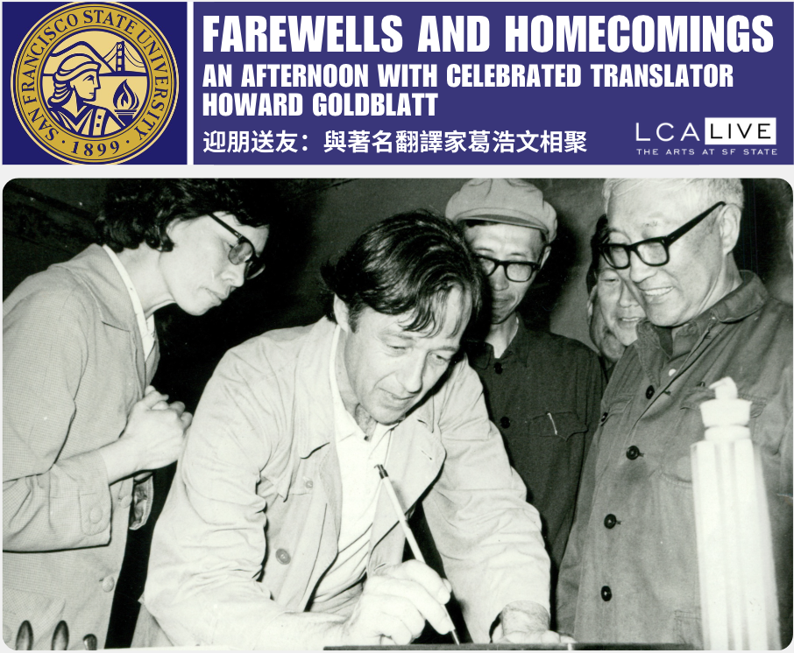

Slide 2
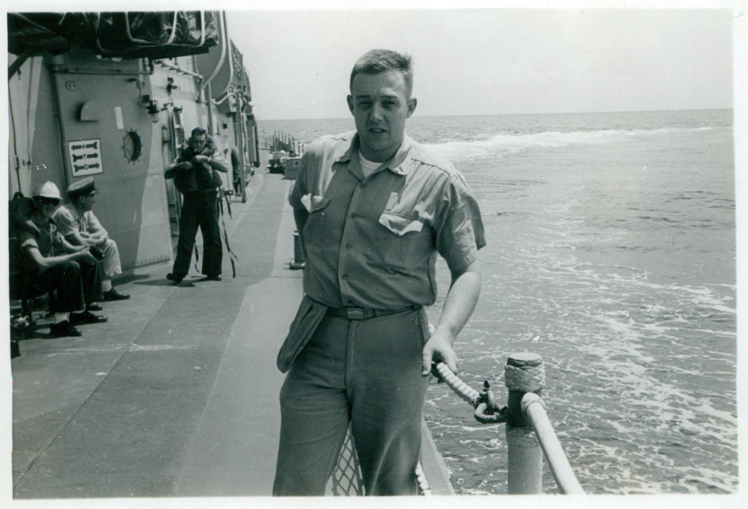

Slide 3
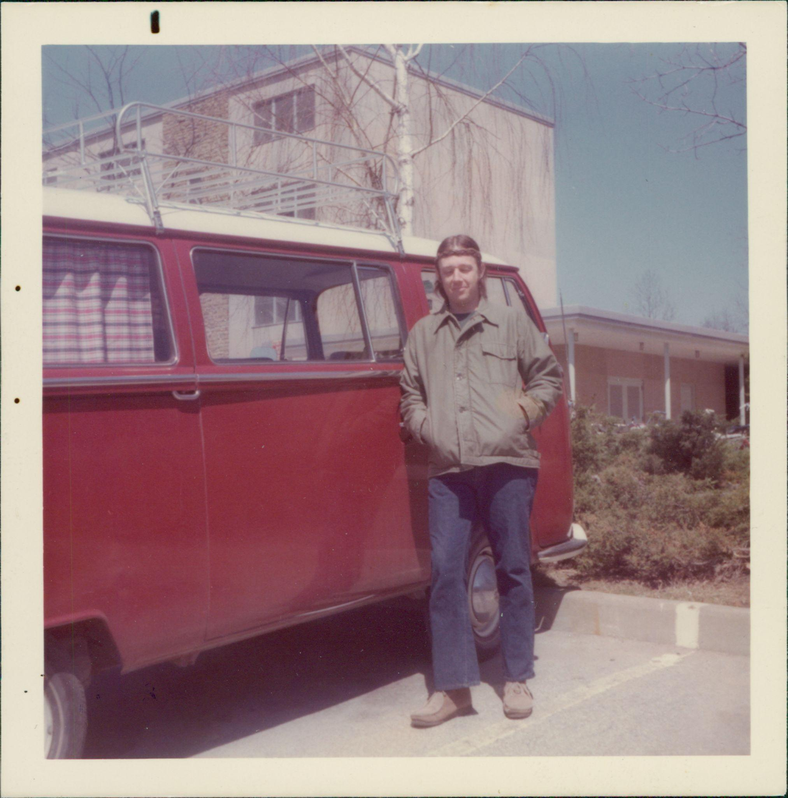

Slide 4
Professor Kai-yu Hsu 許芥昱 (1922-1982)

Slide 5
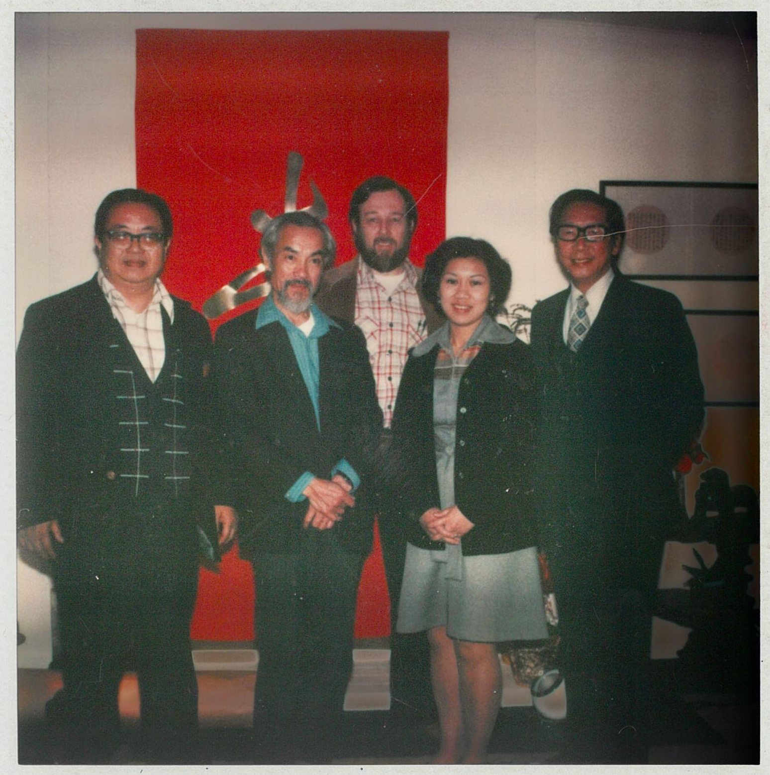

Slide 6
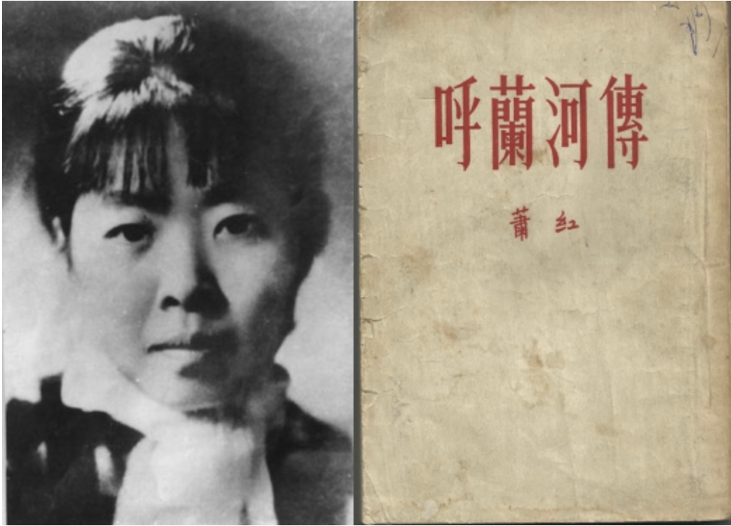
Xiao Hong 蕭紅 (1911-1942)

Slide 7
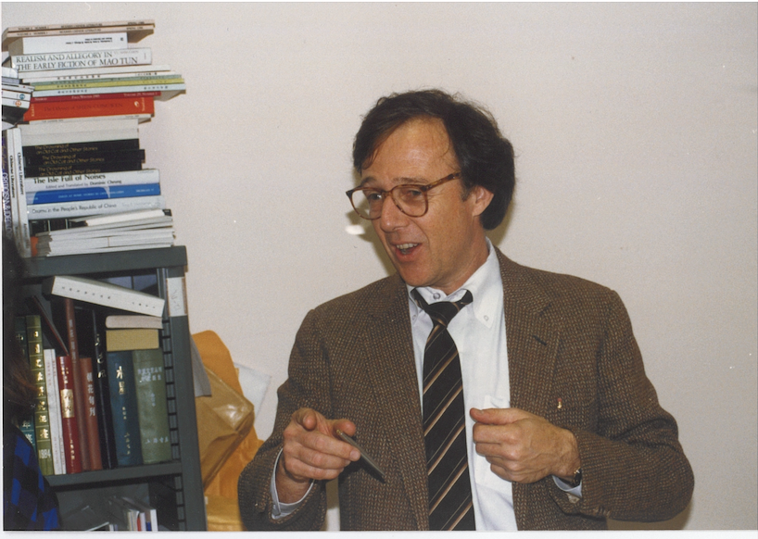

Slide 8
Grave of Xiao Hong 蕭紅 in Hong Kong,1980

Slide 9
1981

Slide 10
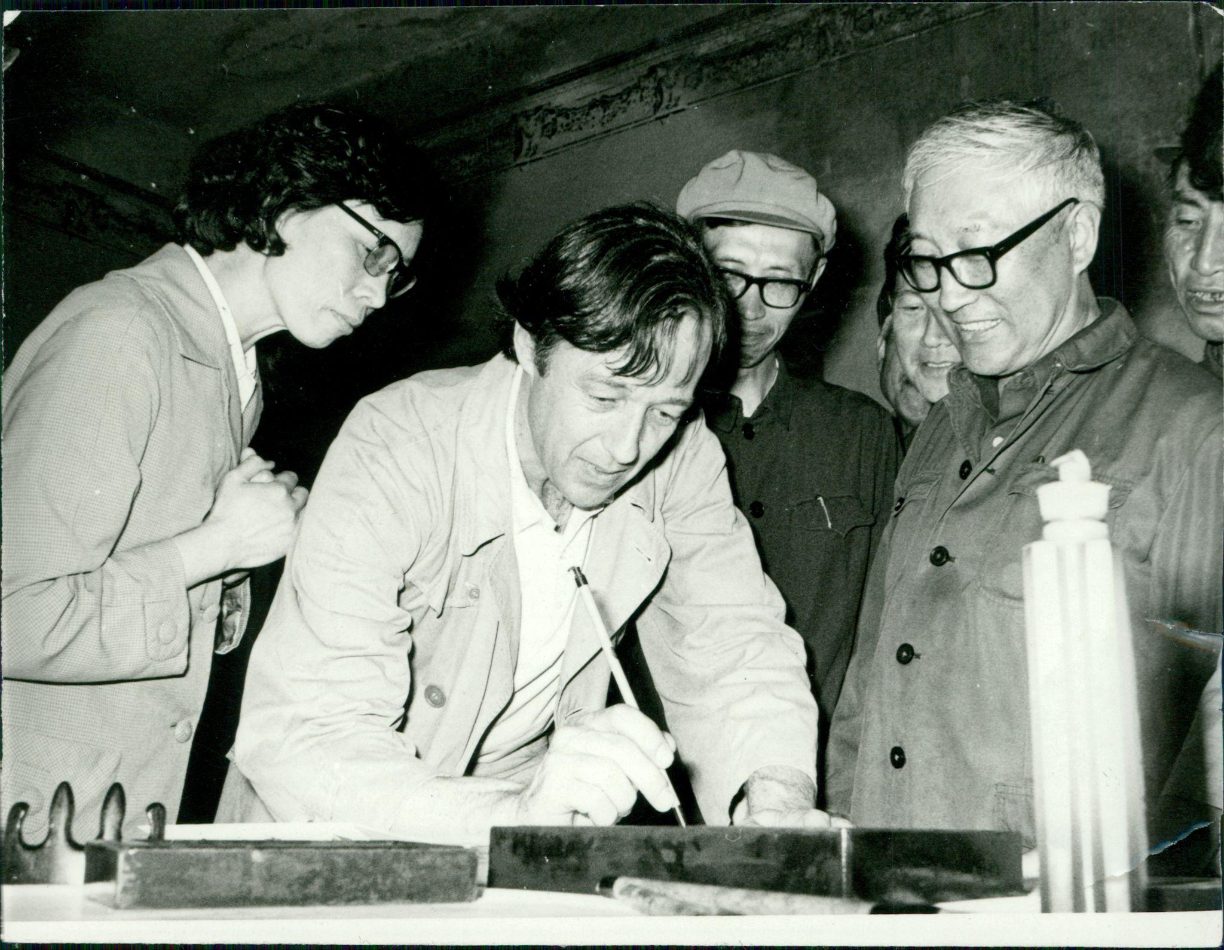

Slide 11
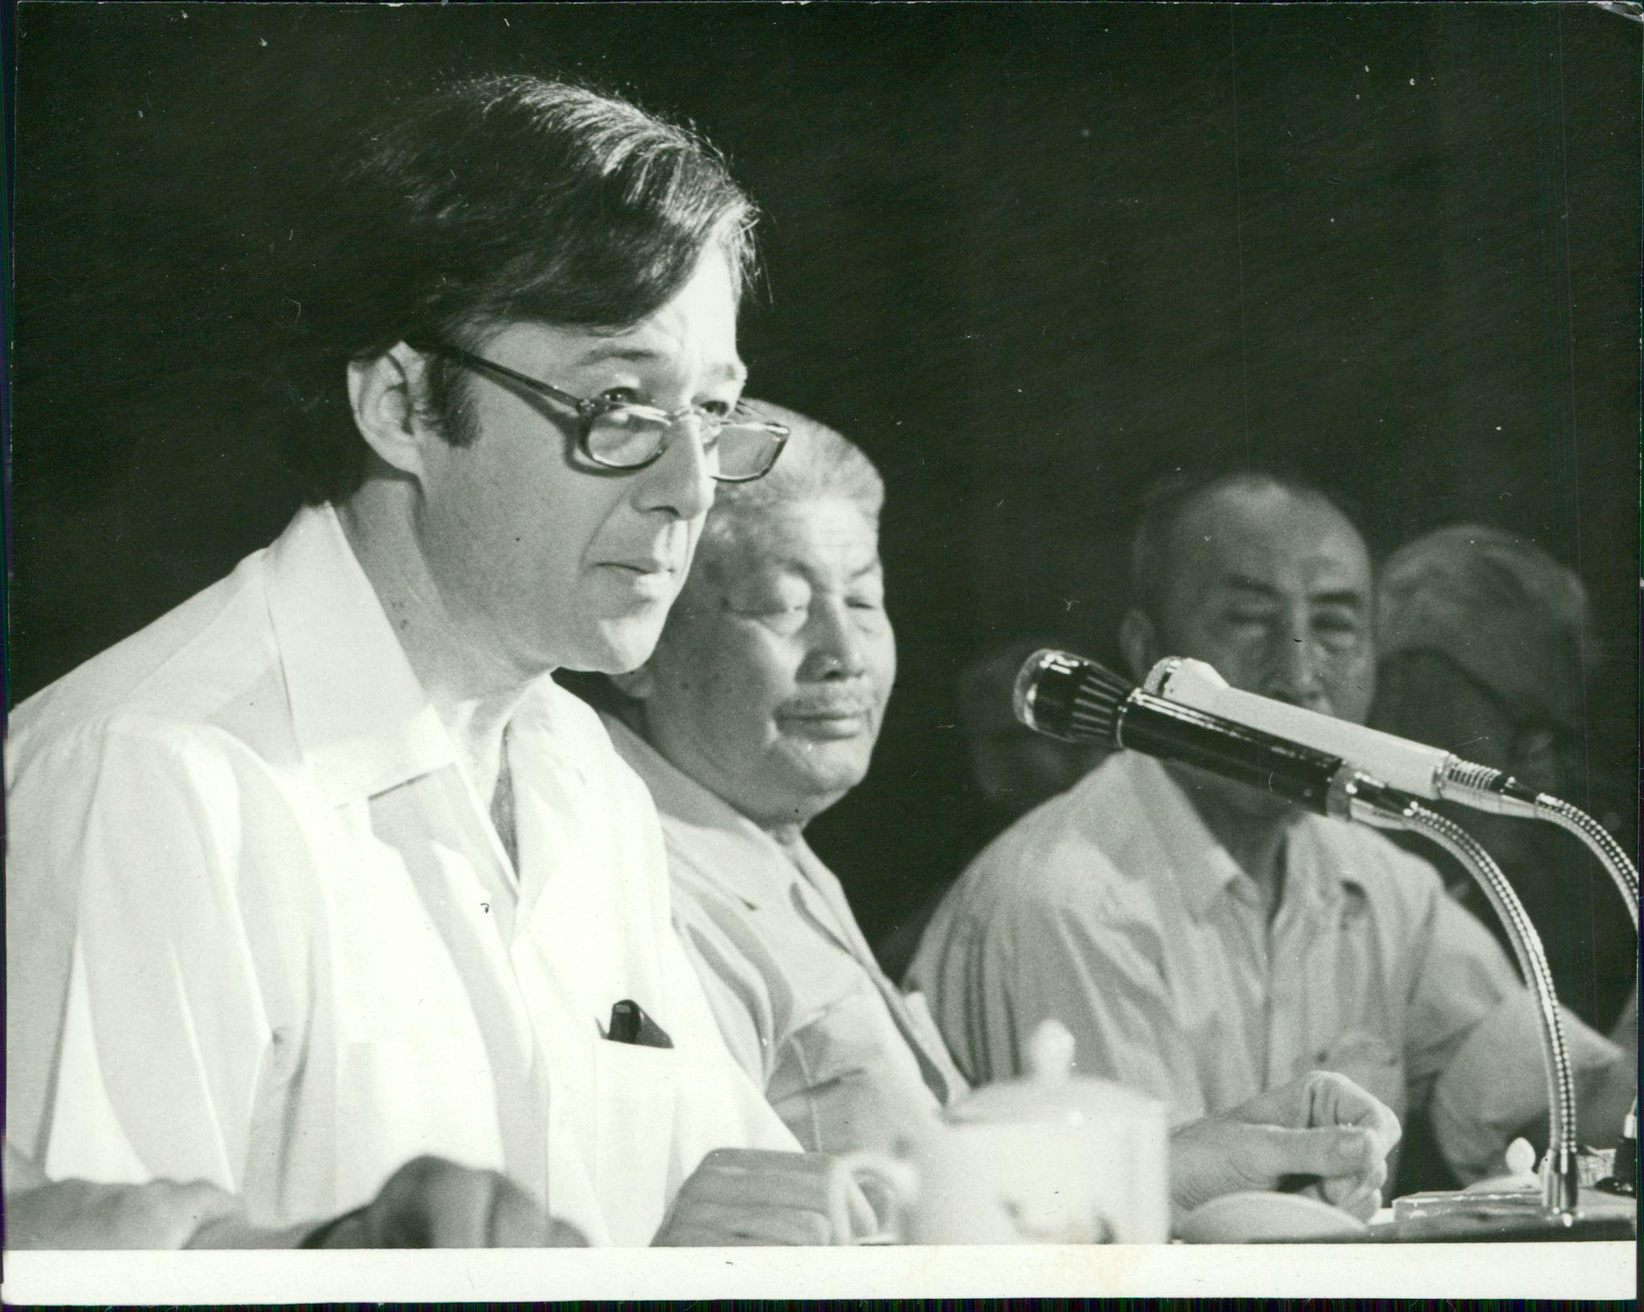
With Xiao Jun 蕭軍 at a Xiao Hong 蕭紅 memorial in the early 1980s

Slide 12
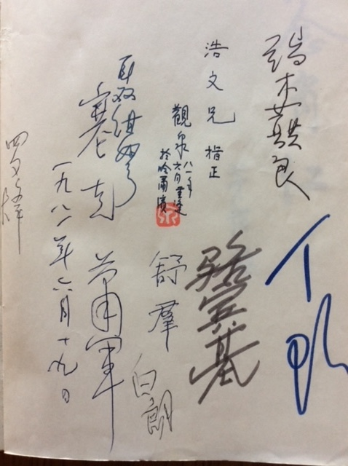

Slide 13
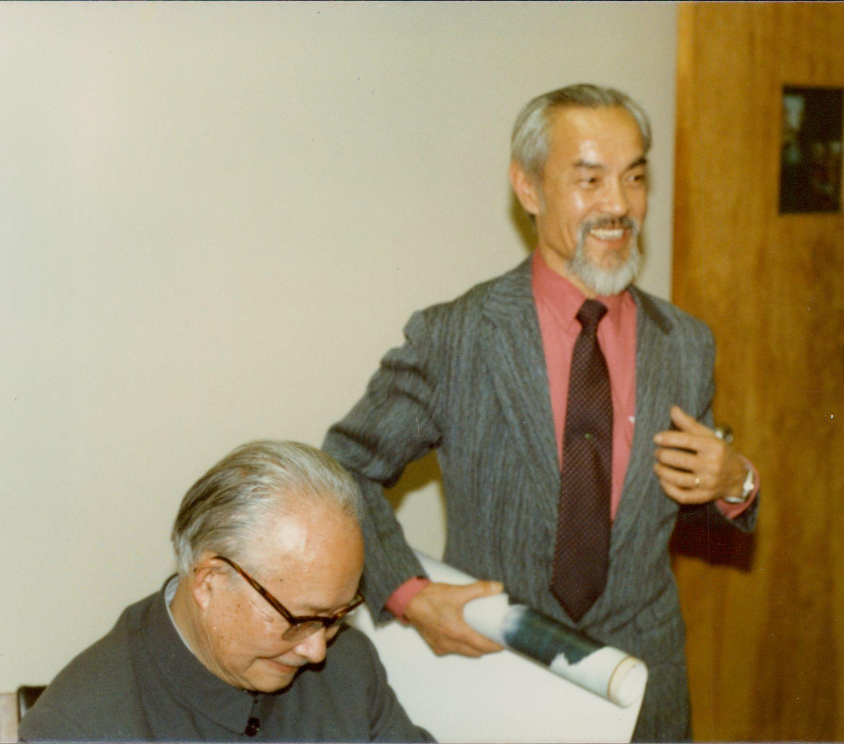
Kai-yu Hsu with Shen Congwen 沈從文 (1902-1988) at SFSU

Slide 14
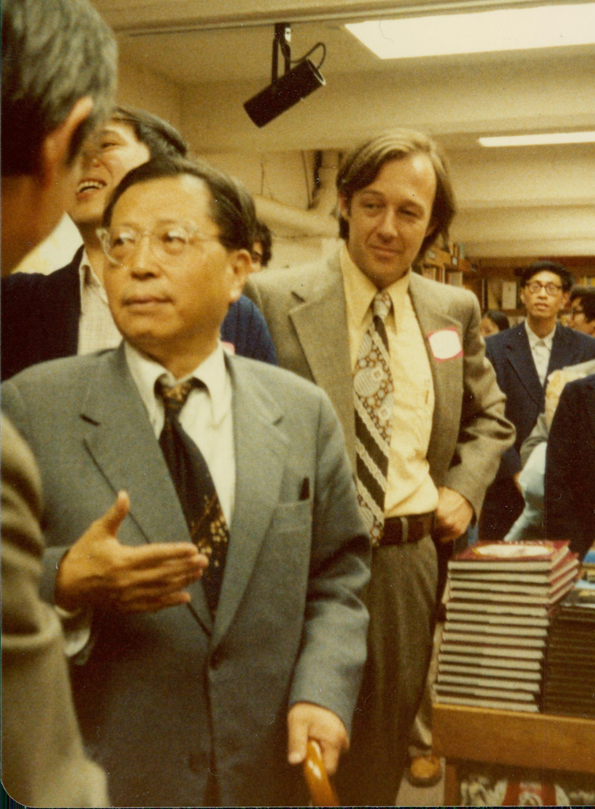
With Cao Yu 曹禺 (1910-1996)
at Eastwind Books in Berkeley in the 1980s

Slide 15
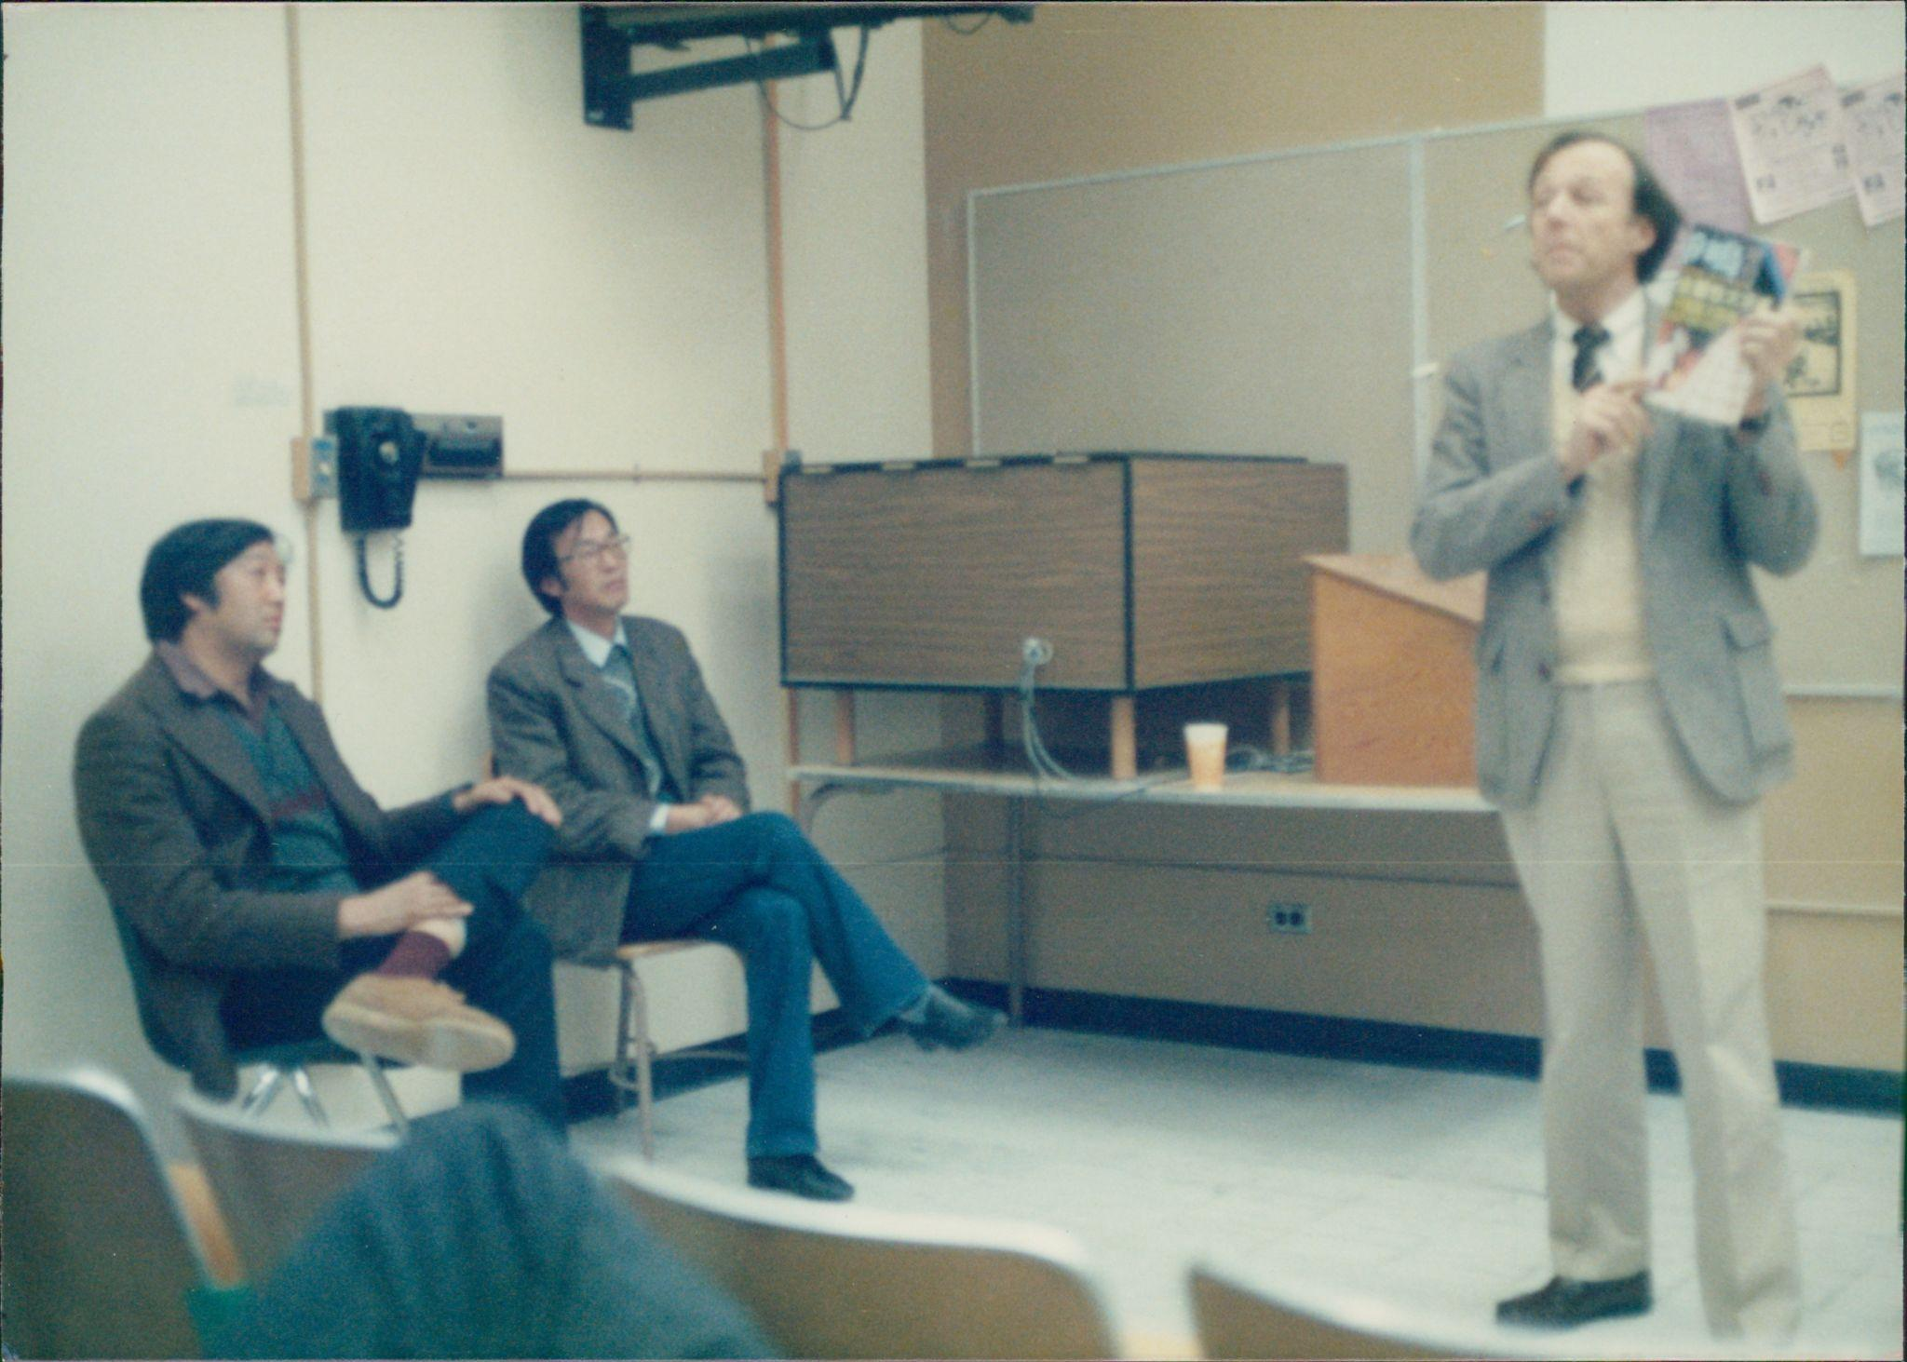
At SF State in 1985 with Feng Jicai 馮驥才 (front) and Zhang Xianliang 張賢亮, author of Half of Man is Woman《男人的一半是女人》

Slide 16
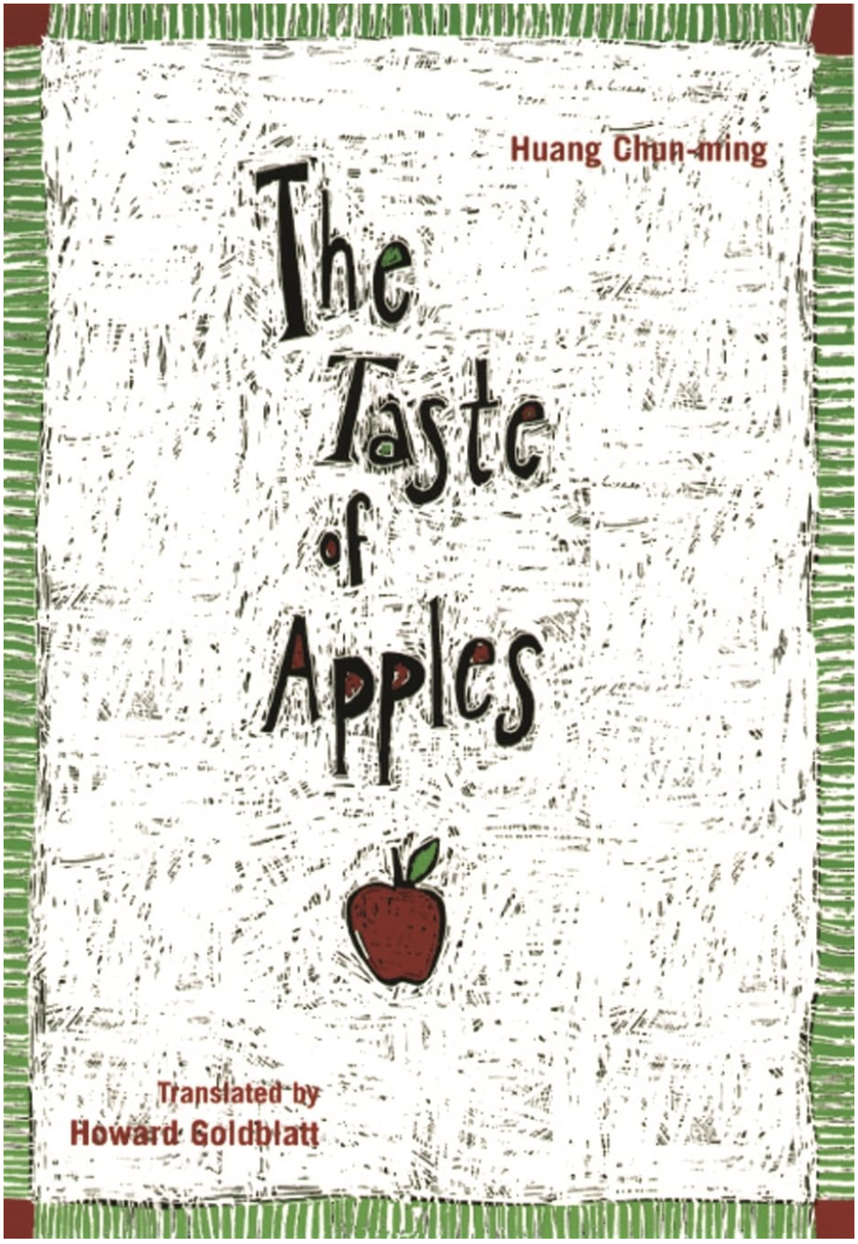
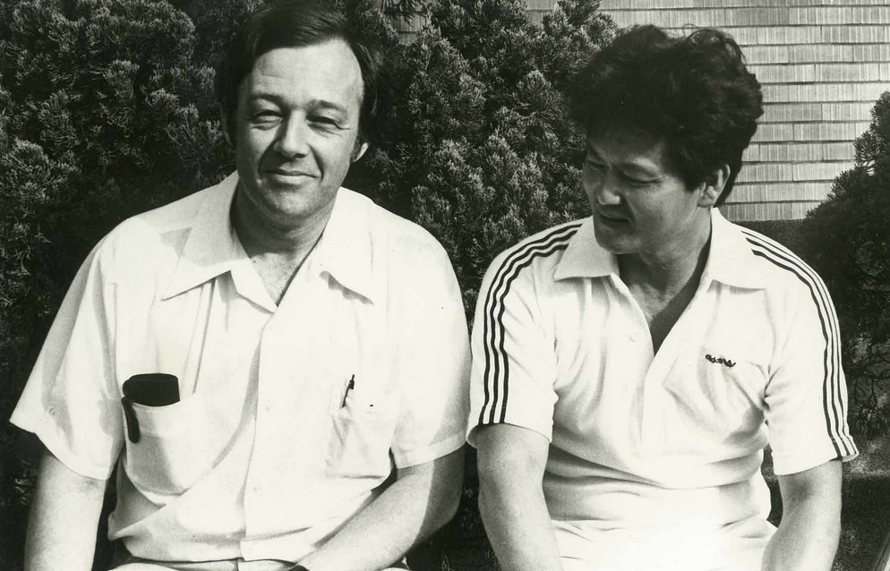
With Huang Chunming 黃春明 (b. 1935) in 1979

Slide 17
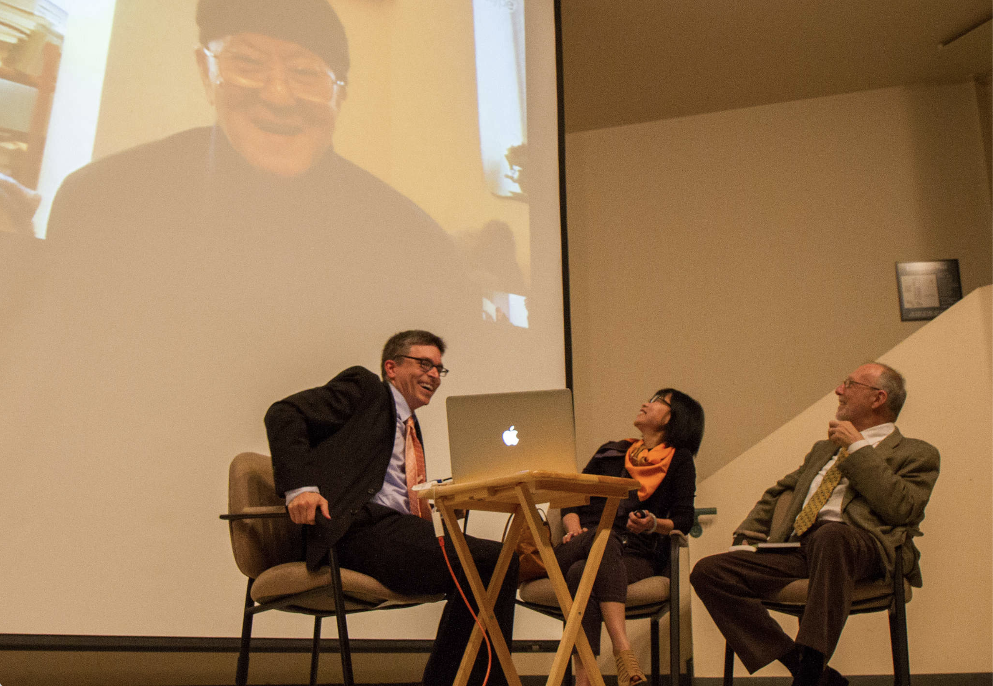
November 10, 2014
At SFSU

Slide 18
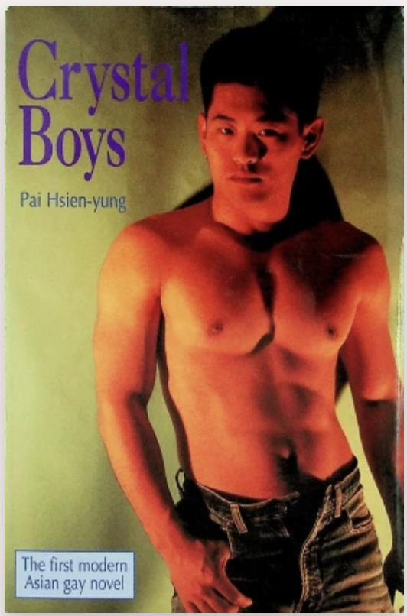
Pai Hsien-yung
白先勇 (b. 1937)

Slide 19
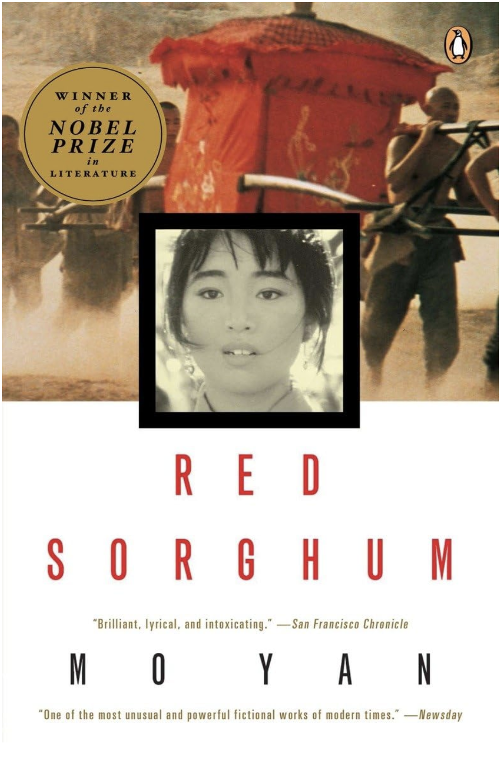
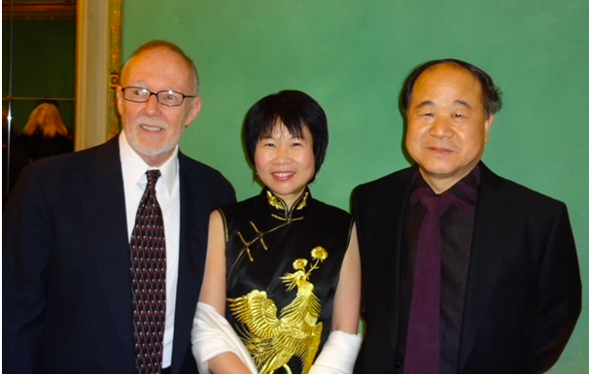
With Mo Yan 莫言 (b. 1955)

Slide 20
Professor Kai-yu Hsu 許芥昱

Slide 22
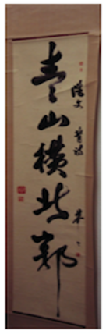
青山橫北郭，白水遶東城
此地一為別，孤蓬萬里征
浮雲遊子意，落日故人情
揮手自此去，蕭蕭斑馬鳴
Green hills lay across the northern wall,
Clear waters wind around the east city.
Here we part, a solitary skiff —
Traveling a thousand miles.
A floating cloud conveys my thoughts,
The setting sun illumes our friendship.
I wave my hand as you depart —
Accompanied by my steed’s sad cry.

